Slide 1
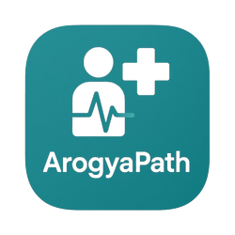
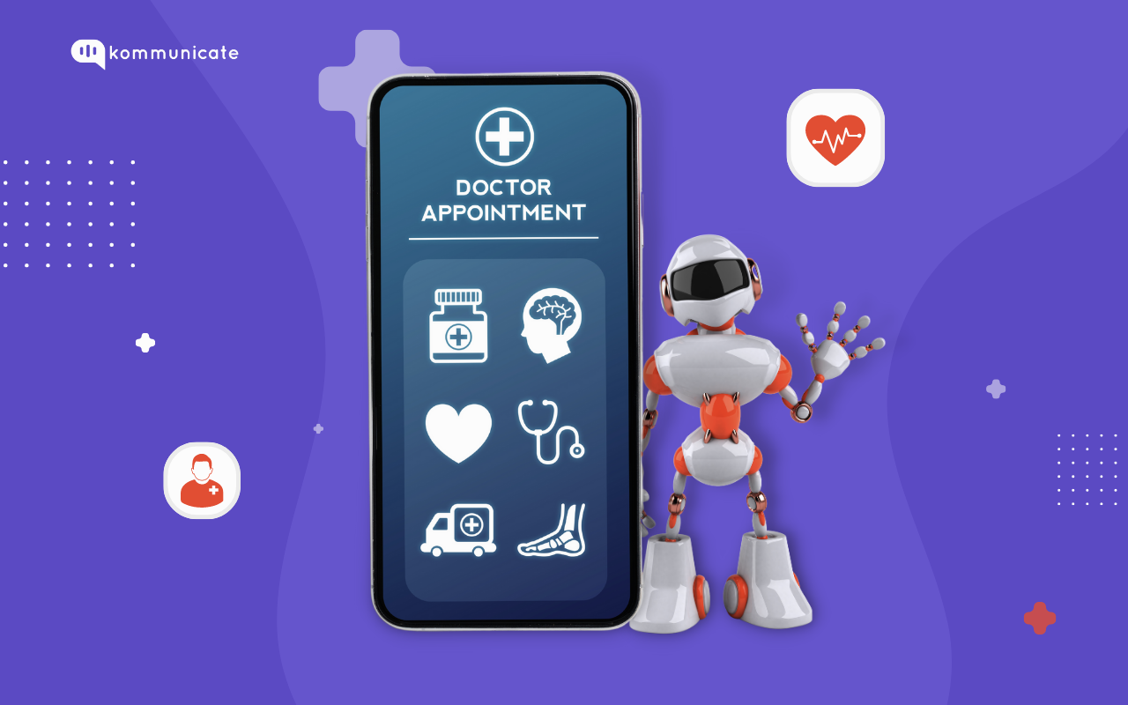
AROGYAPATH
Your AI Wellness Companion for a Healthier Life

Slide 2
Team & Project Identity
Team NEON
Gorle H Y M Venkatadhri Naidu 22BRS1337 (Team Lead)
Team Member | Registration Number | Batch | Department | Year
Gorle H Y M Venkatadhri Naidu | 22BRS1337 | Morning Batch 1 | CSE with spec. in AI and Robotics | 2022-26 4th year
Janhvi Singh | 22BCE8544 | Morning Batch 1 | CSE | 2022-26 4th year
Akshaya Pandian | 23BDS0030 | Morning Batch 1 | CSE | 2023-27 3rd year
Eduru Vysali | 23BCE9986 | Morning Batch 1 | CSE | 2023-27 3rd year
Gajjala Vara Prasad Reddy | 23BCE20169 | Morning Batch 1 | CSE | 2023-27 3rd year
Sanu Kumar Singh | 22BCE3211 | Morning Batch 1 | CSE | 2022-26 4th year

Slide 3
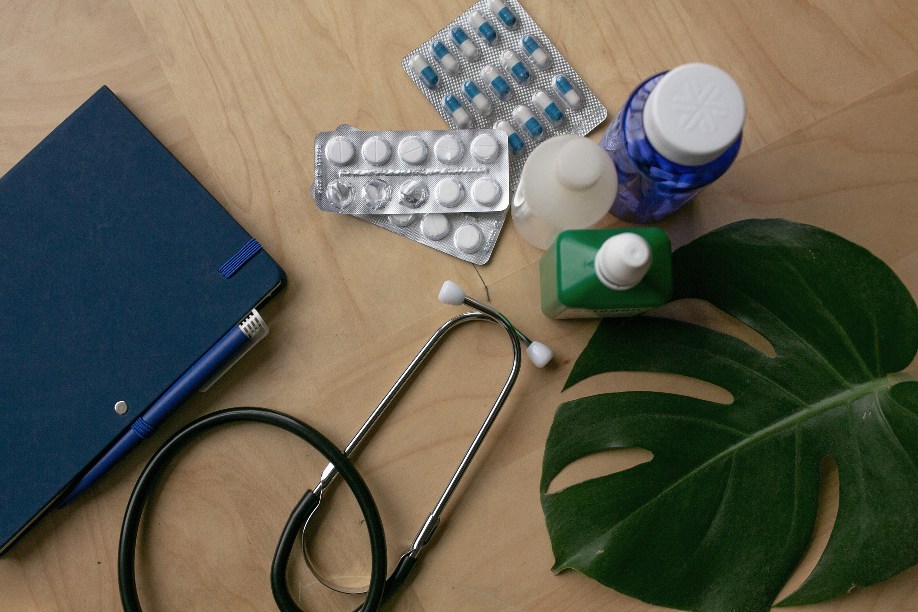

Problem
01
Solution
02
Technical Implementation
03
App Demostration
04

Slide 4

Problem
Lack of Accessible Tools: Many people do not have easy access to tools for daily health tracking and understanding symptoms or natural remedies.
Need for Nearby Medical Assistance: Users often struggle to find nearby hospitals, clinics, or doctors in times of need.
Limitations of Existing Apps: Most current apps focus only on either fitness or symptoms, not both, leading to incomplete health support.
Market Gap :Few platforms offer regional language support, age-specific diet plans, or solutions for chronic care needs.
App Goal: The app is designed to provide daily health tips, symptom insights, and holistic wellness support to users.
Strong Demand: Surveys indicate a growing need for a multilingual, AI-powered health solution, especially after the pandemic.

Slide 5

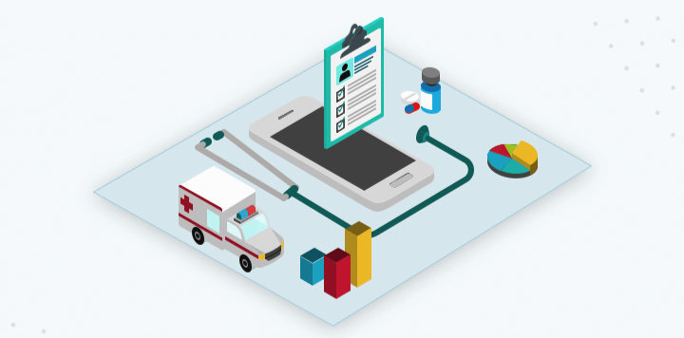
Solution
Daily Health Tracking: Tracks sleep, water intake, steps, mood, and symptoms for overall wellness monitoring.
Symptom Insights: Offers simple, non-diagnostic explanations to promote early health awareness.
Personalized Diet Plans: Provides age-based diet suggestions tailored to the user’s profile.
Daily Health Tips: Shares helpful wellness tips based on user habits and health data.
Natural Remedies: Suggests simple solutions using easily available household ingredients.
Support for Dialysis Patients: Sends timely reminders and safety alerts for managing dialysis schedules.

Slide 6
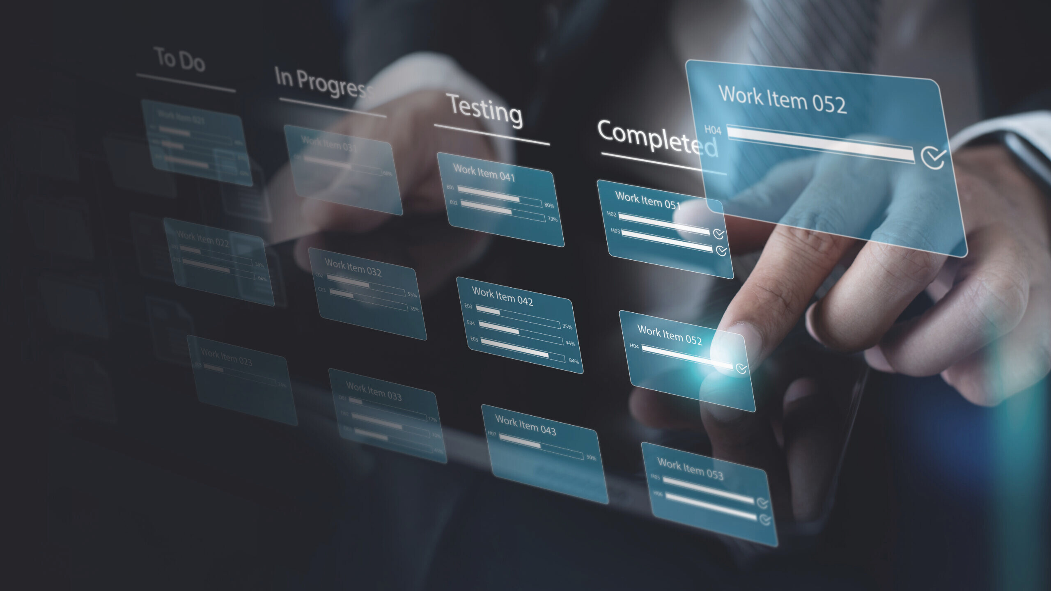
Technical implementation
Layouts & UI Design
Data Binding
Networking & API Integration
AI Integration
Local Storage
Authentication and Security

Slide 7
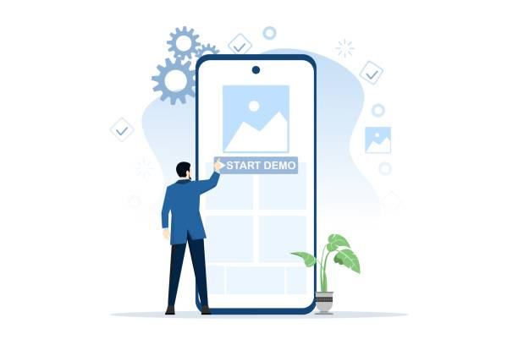
NEON PRESENTATION
App Demonstration

Slide 8
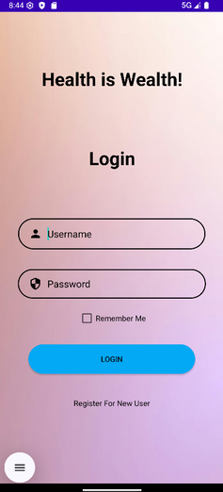
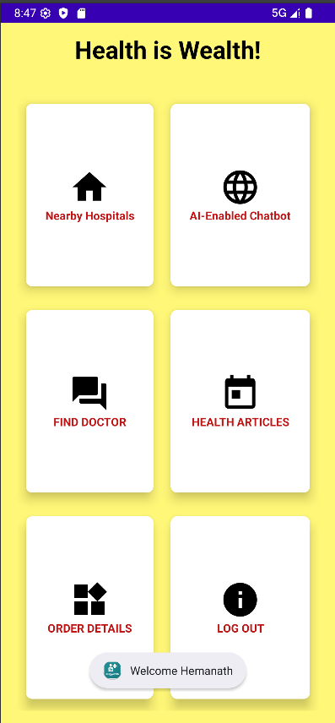
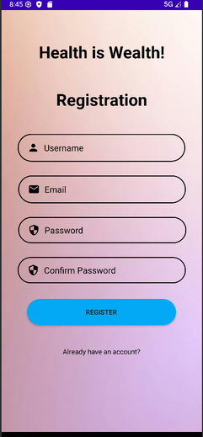
Some Snapshots of Our App
Login Page
Home Page
Register Page

Slide 9
CONTRIBUTION
Name | Contribution Made
Gorle H Y M Venkatadhri Naidu (Team lead) | SQL and ChatBot
Akshaya Pandian | Login and Authentication
Janhvi Singh | Login and Authentication
Eduru Vysali | SQL and ChatBot
Gajjala Vara Prasad Reddy | UI/UX and Frontend
Sanu Kumar Singh | UI/UX and frontend

Slide 10

Thank
You

